Slide 2
ESTIMATED RTD VOLUME over 1 Mio L in FY25
EXTEND JBPR PORTFOLIO WITH KNOWN DRINKS
ACHIEVE 45% SHARE ON VALUE SALES
BECOME LEADER OF RTD SEGMENT
BUILD DISTRIBUTION

Slide 3
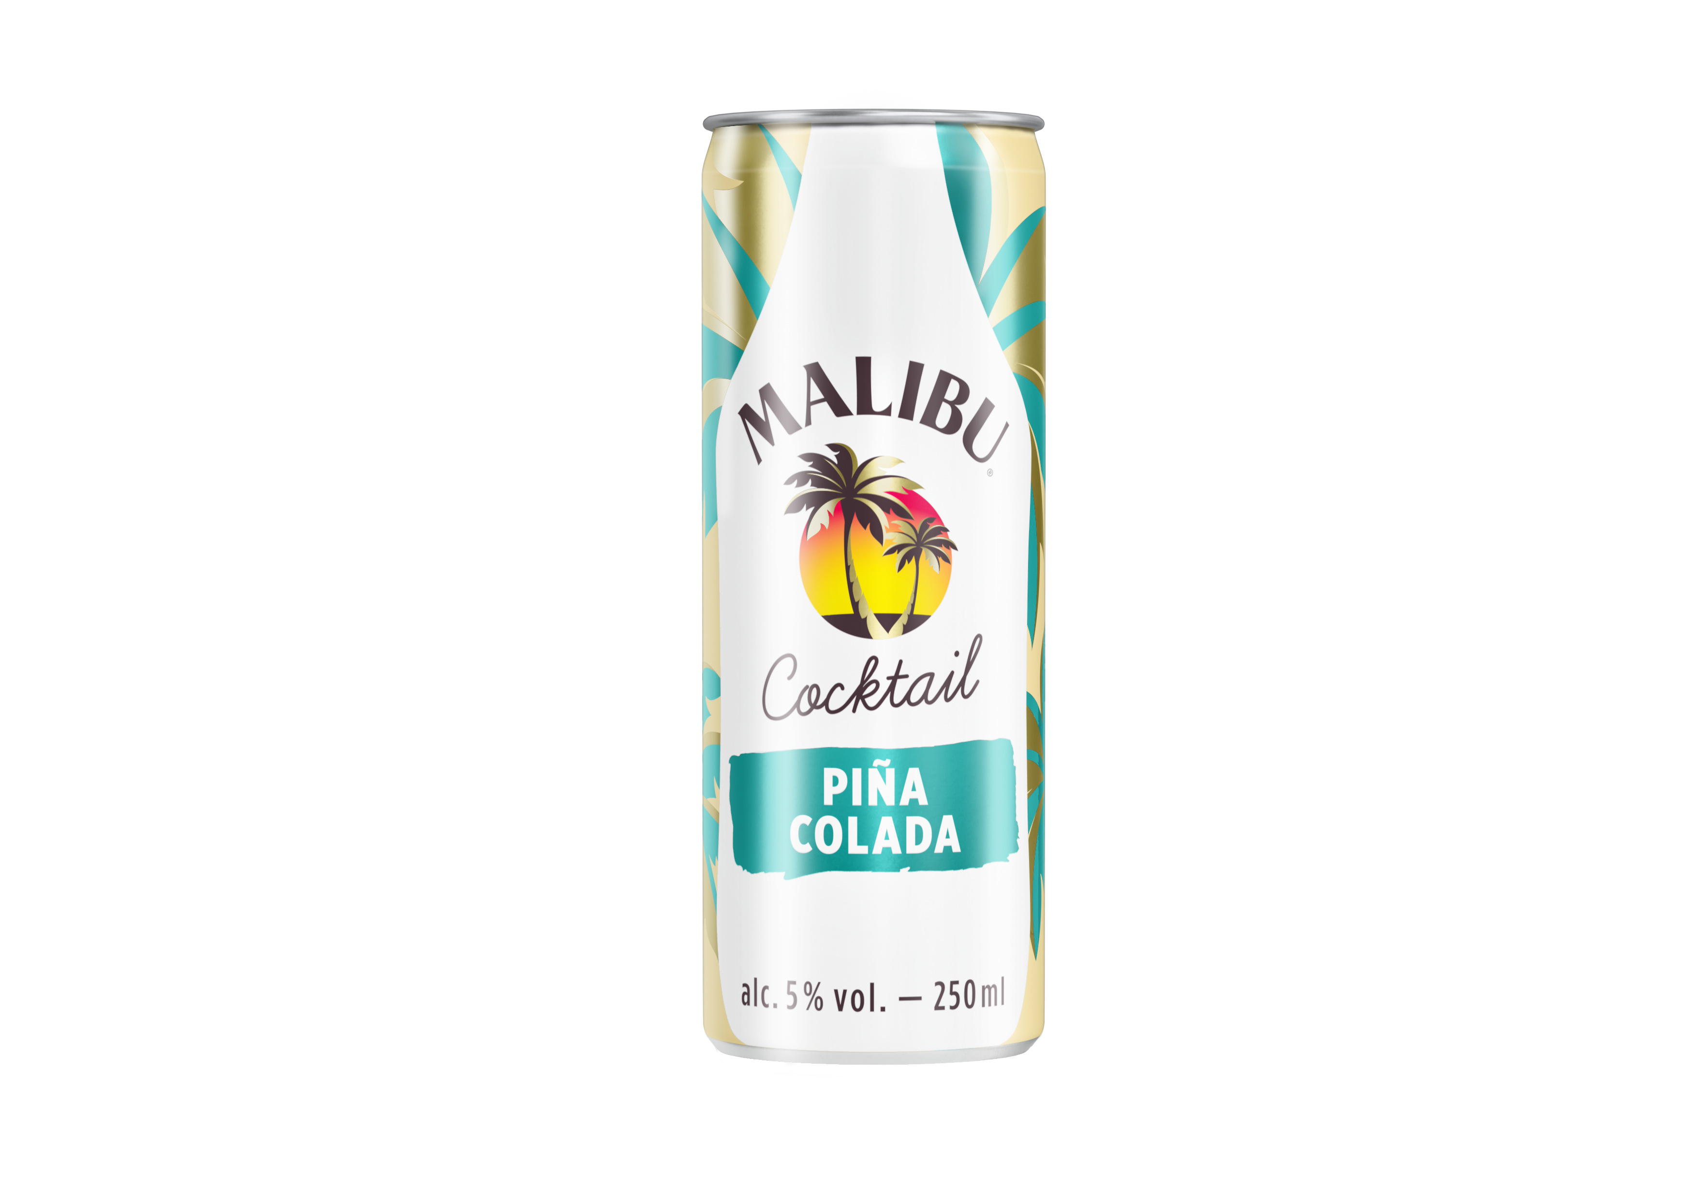
RTD KATEGORIE
WELL KNOWN/STRONG BRAND
OUTSTANDING DESIGN
WELL KNOWN/TRENDY COCKTAIL
ATTRACTIVE FLAVOUR
PRICE

Slide 4
PRICING
PARITY WITH BEEFEATER RTD
RSP 49,9 CZK, RPP: 39,9 CZK
VOLUME FORECAST
10 K L, 40 000 pcs

Slide 5
IN-OUT SUMMER 2023
APRIL MAY JUNE JULY AUGUST SEPTEMBER
LISTING (TIMING, VOLUME PER CHANNEL)
SAMPLES
POSSIBILITY OF LEAFLETS
PROFIWEB

Slide 6
Global reco

